Slide 1
Shaping Your Child’s Biblical Worldview
Joseph Kidder
Katelyn Campbell Weakley

Slide 2
“Parents should direct the instruction and training of their children while very young, to the end that they may be Christians. They are placed in our care to be trained, not as heirs to the throne of an earthly empire, but as kings unto God, to reign through unending ages.”
Ellen White, Patriarchs and Prophets, 244
Notes:
Parents are most important at the beginning of life

Slide 3
“Parents continue to be the single greatest influence on their children’s faith.”
Dustin McClure, “Helping Kids Keep the Faith,” Fuller Youth Institute
Notes:
Worldview established by 12-13, parents have large influence

Slide 4
Worldview Definition
Worldview can be defined as the basic assumptions and beliefs we hold about life which help us interpret and engage with the world around us.
James Sire: “A set of presuppositions or assumptions held consciously or unconsciously, consistently or inconsistently, about the basic make up of reality.”
James Sire, The Universe Next Door, 16.

Slide 5
Worldview Definition
Kevin J. VanHoozer: “A worldview is a way of thinking and living that pursues a way of life intended to achieve or maintain wellness in as many domains as possible, physical, financial, psychological, professional, social, and intellectual.”
Paul Hiebert has called worldviews “unseen structures underlying the entire explicit culture.”
Kevin VanHoozer, “Being Biblical in a Pluralistic Age.” Andrews University Seminary Studies 57 no. 2, 2019, 310.
Paul Hiebert, Transforming Worldviews: An Anthropological Understanding of How People Change, 32.

Slide 6
Biblical Worldview Definition
A Biblical worldview is a way of thinking that identifies and explores the Biblical paradigm, builds a Biblical truth framework, develops a Biblical philosophy of life, and evaluates any new input through the Biblical worldview grid one has developed.
Del Tackett: “When you believe the Bible is entirely true, then you allow it to be the foundation of everything you say and do.”
Del Tackett “What’s a Christian Worldview?” Focus on the Family

Slide 7
The worldview that your child develops will answer key questions for them:
Who am I?
Why am I here?
Where do I come from?
Where am I going?
What is real?
What is right and wrong?

Slide 8
Children begin developing worldview by the age of 2.
A child’s moral compass is fairly determined by the age of 9.
By the time a child turns 13, worldview is usually fully formed.
Barna Group, Ltd., “Changes in Worldview Among Christians over the Past 13 Years.”

Slide 9
The assumptions and perceptions that comprise a child’s worldview not only answer basic questions about the world, but they help establish the child’s values and priorities, which in turn direct behavior and decision-making.

Slide 10
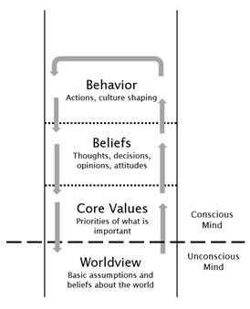

Slide 11
In order to make positive, healthy decisions, a child needs a positive, healthy worldview. A Biblical worldview can help children make intelligent decisions that will honor God and be a benefit to others as well as themselves.

Slide 12
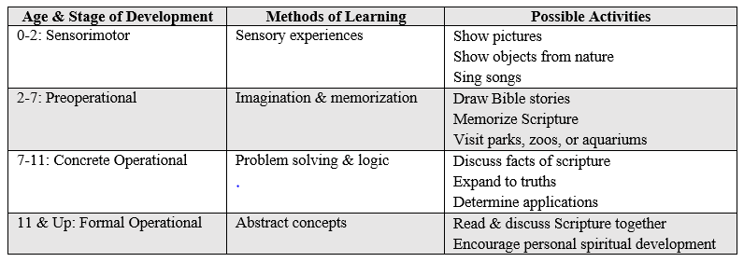
Stages of Learning

Slide 13
Sensorimotor Stage
Birth to 2 years old
Learn through personal sensory engagement with the world: touching, tasting, watching, smelling, hearing
The world begins to be ordered through manipulating objects within it

Slide 14
Activities for Sensorimotor Worldview Building
Visually show children pictures of animals or Bible characters
Sing Bible-oriented songs with your children
Guide children in folding their hands for prayer
Give children leaves, rocks, or other objects from nature to touch and hold

Slide 15
Preoperational Stage
2 to 7 years old
Learning occurs through imagination and memory growth
Symbolic ideas begin to take on meaning

Slide 16
Activities for Preoperational Worldview Building
Guide children in drawing or acting out Bible stories
Take children to visit a zoo, aquarium, or park to learn about plants and animals
Map out the basic timeline of Scripture so children recognize events of the past, present, and future
Instruct children in Scripture memorization

Slide 17
Concrete Operational Stage
7 to 11 years old
Learning occurs through processing facts and their application
Children develop logical thought processing and internal problem solving

Slide 18
Activities for Concrete Operational Worldview Building
Enjoy reading Scripture with your children
Establish facts found in Biblical stories
Discuss what lessons and principles can be found in these stories
Identify with your children what differences these lessons make in their lives

Slide 19
Formal Operational Stage
11 years old and beyond
Learning occurs by logically working through more complex mental problems
Children are able to comprehend more abstract concepts, moving from simple facts to deeper, life-changing ideas

Slide 20
Activities for Formal Operational Worldview Building
Teach children that every part of Scripture is for spiritual growth and maturity
Encourage children to take the Biblical story as their own personal story

Slide 21
“They reminded Jesus of his identity as the Son of God. They taught him through songs and through nature. As they taught him, they themselves grew and learned more about God and his scriptures.”
Ellen White, Youth’s Instructor (Sept. 8, 1898)
Notes:
Teach about the character of God: his love, compassion, mercy, etc.

Slide 22
Culture Versus Microculture
51% believe that the nation’s current pervasive culture has an overall negative effect upon children and teenagers.
93% of adults who claim a Biblical worldview believe that culture negatively impacts children,
48% adults who do not ascribe to a Biblical worldview still say that the country’s common culture affects children in a poor way.
George Barna, “Americans Worried About Children,” June 28, 2017.

Slide 23
“Teach the young tendrils to entwine about God for support. It is not enough that you say, Do this, or, Do that, and then become utterly regardless and forgetful of what you have required, and the children are not careful to do your commands. Prepare the way for your child to obey your commands cheerfully; teach the tendrils to cling to Jesus.... Teach them to ask the Lord to help them in the little things of life; to be wide awake to see the small duties which need to be done.”
Ellen White, Child Guidance, 31.

Slide 24
Culture
“A culture is composed of ideas, behavior, and material possessions. Society and culture are interdependent; neither could exist without the other.”
Visible and invisible, subtle and explicit, culture both expresses and influences ideas, knowledge, behavior, and attitudes.
Kendall, Diana. Sociology in Our Times: The Essentials, 5th ed., 42.

Slide 25
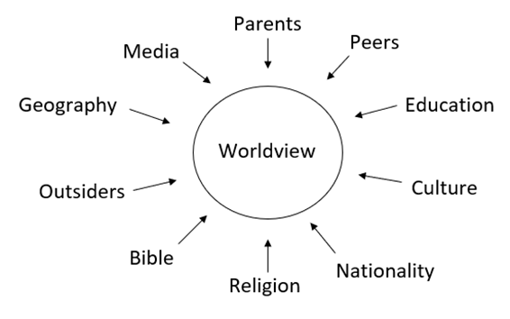
Influences on Worldview

Slide 26
Microculture
While your family is set in the midst of local culture—complete with language, traditions, media, etc.—the family is itself a distinct culture. It can be influenced by surrounding cultural aspects, but it has its own established rules, customs, and ways of doing life.

Slide 27
Thus, the question to parents remains:
What kind of microculture do you want your family to have?

Slide 28
“Prayerfully, unitedly, the father and the mother should bear the grave responsibility of guiding their children aright.”
Ellen White, Review and Herald, Sept 8, 1904.

Slide 29
“Finally, brethren, whatever things are true, whatever things are noble, whatever things are just, whatever things are pure, whatever things are lovely, whatever things are of good report, if there is any virtue and if there is anything praiseworthy—meditate on these things.”
Philippians 4:8
If you are incorporating language that is lovely, media that is pure, rules that are just, and the like, you are creating an external framework to positively influence your children.

Slide 30
“You will show me the path of life;
In Your presence is fullness of joy;
At Your right hand are pleasures forevermore”
Psalm 16:11

Slide 31
An Example of Parenting from Scripture
“…I call to remembrance the genuine faith that is in you, which dwelt first in your grandmother Lois and your mother Eunice, and I am persuaded is in you also.”
1 Timothy 1:5

Slide 32
“Then [Paul] came to Derbe and Lystra. And behold, a certain disciple was there, named Timothy, the son of a certain Jewish woman who believed, but his father was Greek. He was well spoken of by the brethren who were at Lystra and Iconium.”
Acts 16:1,2

Slide 33
“the piety and influence of his home life was not of a cheap order, but pure, sensible, and uncorrupted by false sentiments. The moral influence of his home was substantial, not fitful, not impulsive, not changeable. The Word of God was the rule which guided Timothy. He received his instruction line upon line, precept upon precept, here a little, and there a little. Impressions of the highest possible order were kept before his mind. His home instructors cooperated with God in educating this young man to bear the burdens that were to come upon him at an early age.”
Ellen White, SDA Bible Commentary, vol. 7, 918.

Slide 34
The Responsibility of the Community of Faith
“For this reason I have sent Timothy to you, who is my beloved and faithful son in the Lord, who will remind you of my ways in Christ, as I teach everywhere in every church.” 1 Corinthians 4:17
Paul desired to build a culture of mentorship within the church, something which he himself modeled and instructed others to do as well. Here we can clearly see the need for young people to have additional teachers and mentors outside of their immediate family.

Slide 35
“…Older men be sober, reverent, temperate, sound in faith, in love, in patience; the older women likewise, that they be reverent in behavior not slanderers, not given to much wine, teachers of good things—that they admonish the young women to love their husbands, to love their children, to be discreet, chaste, homemakers, good, obedient to their own husbands, that the word of God may not be blasphemed. Likewise, exhort the young men to be sober-minded, in all things showing yourself to be a pattern of good works; in doctrine showing integrity, reverence, incorruptibility, sound speech that cannot be condemned, that one who is an opponent may be ashamed, having nothing evil to say of you.”
Titus 2:2-8

Slide 36
Concluding Remarks

